Slide 1

Team Foundation Server
Session 1 – Introduction, Getting Connected & Source Control

Slide 2
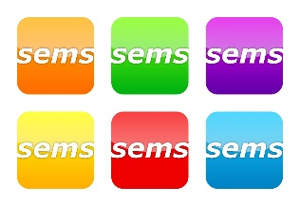

Agenda
What is Team Foundation Server (TFS)?
Why should I use TFS?
How do I connect to TFS?
Source Control
Workspaces
Project Structure
Check-in & Checkout
Branching / Merging
Shelve sets
Team Builds

Slide 3
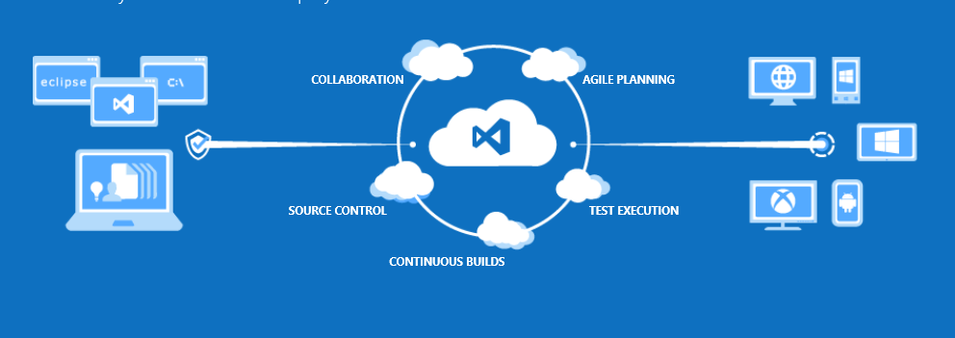
What is Team Foundation Server (TFS)?
Visual Studio Team Foundation Server 2012 (TFS) is a collaboration platform that facilitates an application lifecycle management (ALM) solution.

Slide 4
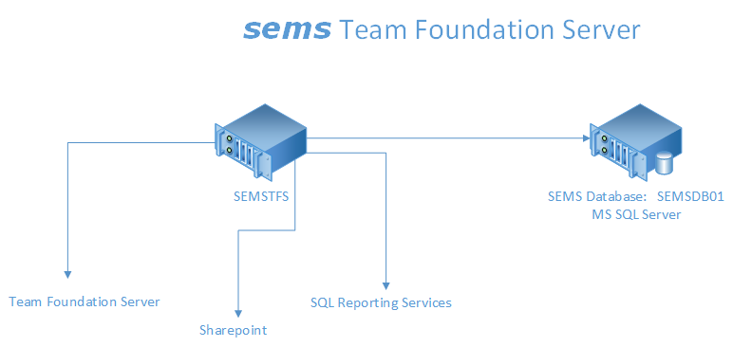
Backed up nightly
Backups moved off-sight weekly
Support is M-F, 8:00 am – 5:00 pm
SAN based storage model – “double redundant”

Slide 5
Why should I use TFS?
Collaboration
Source Control Integration
Specification Storage
WBS (Work Breakdown Structure)
Progress Reports
Integrated Builds
Enables and Supports process

Slide 6
Why should I use TFS? – Source Control
Benefits:
Protect Corporate IP
Backup work
Follow progress, history
Store ‘Milestones’
Reproducibility
Sharing Code
Many more …

Slide 7
Why should I use TFS?
The Joel Test
Do you use source control?
Can you make a build in one step?
Do you make daily builds?
Do you have a bug database?
Do you fix bugs before writing new code?
Do you have an up-to-date schedule?
Do you have a spec?
Do programmers have quiet working conditions?
Do you use the best tools money can buy?
Do you have testers?
Do new candidates write code during their interview?
Do you do hallway usability testing?
“A score of 12 is perfect, 11 is tolerable, but 10 or lower and you've got serious problems. The truth is that most software organizations are running with a score of 2 or 3, and they need serious help, because companies like Microsoft run at 12 full-time.”
http://www.joelonsoftware.com/articles/fog0000000043.html - August 9, 2000

Slide 8
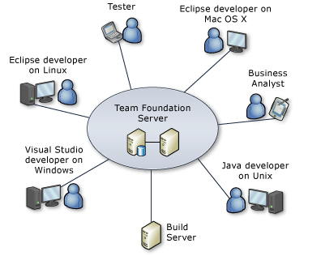
How do I connect to TFS? - Windows
Need ‘Visual Studio Team Explorer’ installed
Need License to connect – CAL (Client Access License) – Team Explorer
If you have any MSDN subscription – you’re licensed

Slide 9
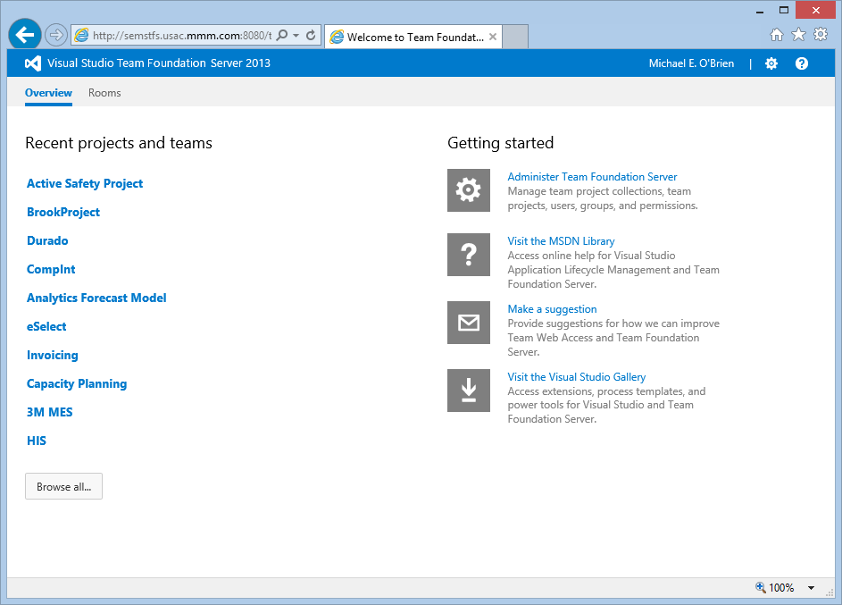
How do I connect to TFS? – Team Web Access
But I don’t want to install anything …
Team Web Access: http://semstfs:8080/tfs/

Slide 10
How do I connect to TFS?
Mac OS X / Linux / Unix
TFS Everywhere – installs into Eclipse perspective
http://msdn.microsoft.com/en-us/library/gg413285.aspx
Xcode
Team Foundation Server 2012 with GIT support
http://blogs.msdn.com/b/bharry/archive/2013/02/11/ctp-for-visual-studio-2012-update-2-vs-2012-2-is-available.aspx

Slide 11
How do I connect to TFS? – Etc …
But I have “Development Env X” and I NEED environment integration
Team Foundation Server MSSCCI Provider
http://visualstudiogallery.msdn.microsoft.com/b5b5053e-af34-4fa3-9098-aaa3f3f007cd

Slide 12
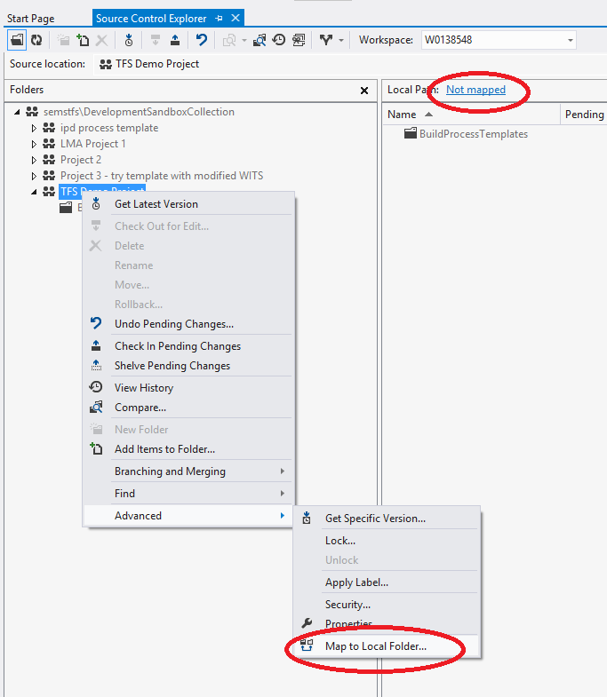
Workspaces
Map the source control folder to a local folder
Recommend mapping the top level source control folder to a short local path
$/ProjectName ➔ c:\projects\ProjectName

Slide 13
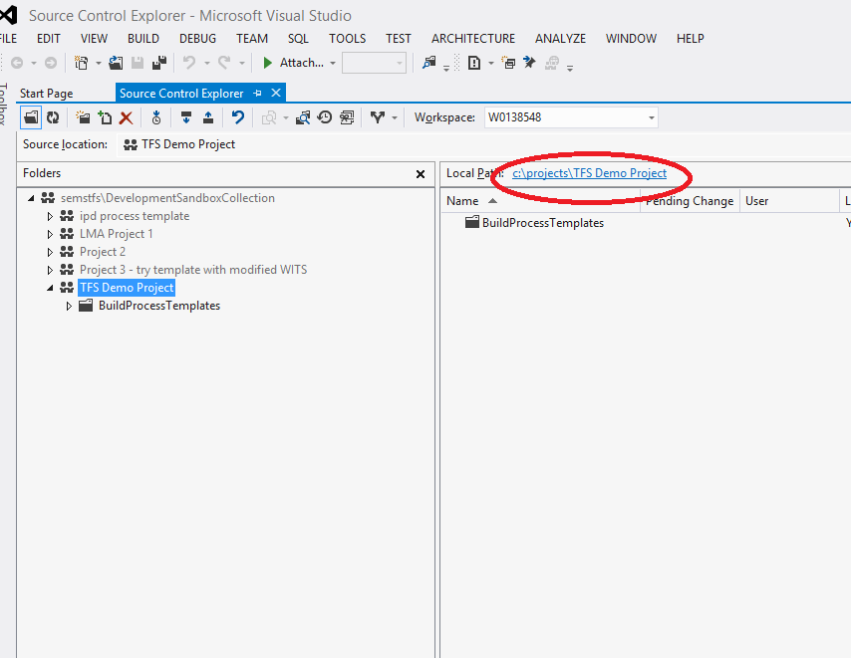
Workspaces
Map the source control folder to a local folder
Recommend mapping the top level source control folder to a short local path
$/ProjectName ➔ c:\projects\ProjectName

Slide 14
Workspaces
You can map individual folders to local folders if needed
This approach is powerful for configuration, but can be confusing for long term support
Can assign security permissions per folder – leads to confusion unless tightly managed

Slide 15
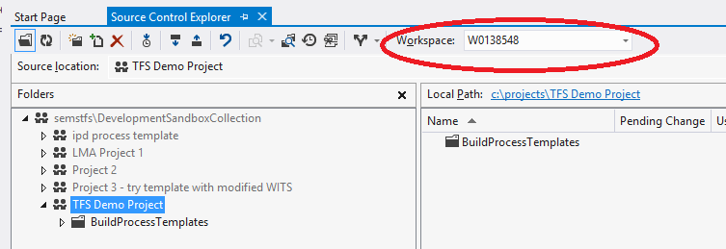
Workspaces
You can have multiple workspaces - default is your computer name
If using multiple computers, you will have multiple Workspaces – but each is computer specific. I.e., not re-usable across computers

Slide 16
Source Control – Project Structure
Promotion Model
QA
Prod
Dev

Slide 17
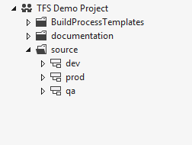
Project Structure
When setup in source control, provides a path for source code management
Demo – how to setup a new Team Project

Slide 18
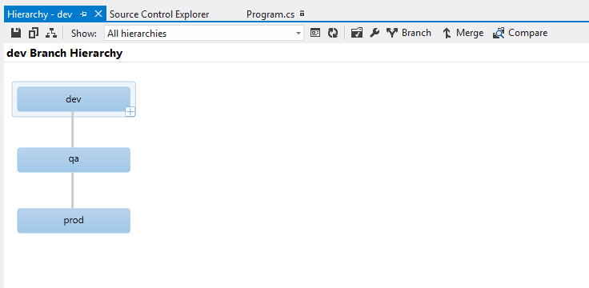
Project Structure
Tools in Visual Studio help with source code management
Enable visualization of code with tools to compare and merge
Visual Studio 2012 – new merge tool.

Slide 19
Check in & Check out
How do I get my code into TFS?
Easiest Method
create and/or copy code into working path
“add to source control”
Check in
Note: each Check-in is call a ‘Changeset’ within TFS – and assigned an Id
If you have Power Tools installed – add from Windows Explorer

Slide 20
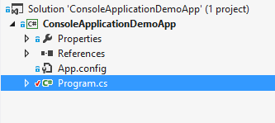
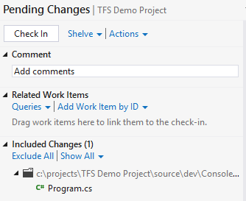
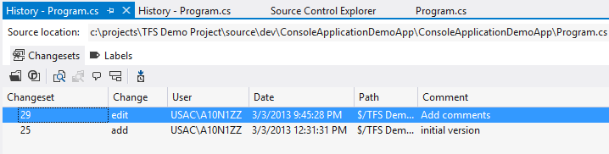
Check in & Check out
How do I get my Team’s code?
Easiest Method
Get Latest on top level folder, or on Solution
Demo: show Check in, Check out, Get Latest, Show History

Slide 21
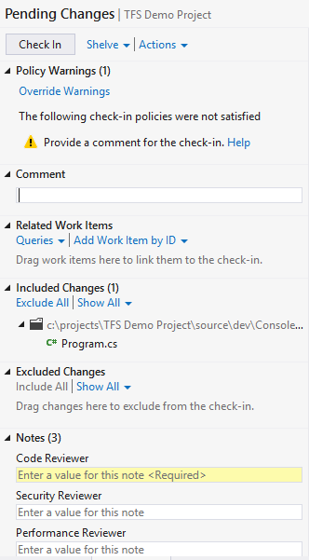
Check in & Check out
Check-in Policies - Allows the team to set norms and enforce, such as:
Check-in comments
Check-in Notes – similar – require notes at Check-in time
Demo: show Check in, Check out, Get Latest, Show History

Slide 22
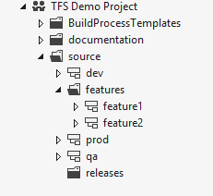
Branching / Merging
Can get complicated – keep it as simple as possible
Increased team size or <1 teams = more complicated
Merge as often as possible – keeps conflicts to minimum

Slide 23
Branching / Merging
Demo – Branching / Merging

Slide 24
Shelvesets
Shelvesets are useful when you want to stop work for:
Interruption: You have pending changes that are not ready for check in, but you need to work on a different task.
Collaboration: You have pending changes that are not ready for check in but you need to share them with another team member.
Code Review: You want another team member to perform a code review of your pending changes.
Private Build: Before you check in your changes, you can use your automated build system to build and test your code.
Backup: You have work in progress that you cannot finish now so you want a backup copy that is stored on your server and available to other team members who might need to access it.
Handoff: You have work in progress that you want to hand off to another team member.
Suspend Your Work and Manage Your Shelvesets
http://msdn.microsoft.com/en-us/library/ms181403.aspx

Slide 25
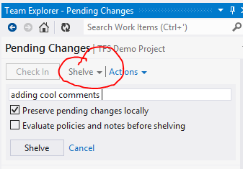
Shelvesets
Demo – Shelve a change

Slide 26
Automated Builds
Perform a build on ‘trigger’ operations, such as:
Code Check-in (Continuous Integration)
Fixed time (nightly build)
Requested (manual build)
Automated build can also run Unit Tests to ensure new code is passing automated tests
Tip: When performing an automated build, use the Workspace to only retrieve the minimum source code

Slide 27
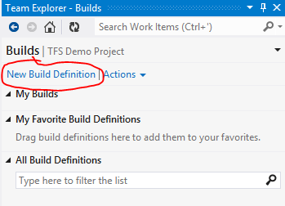
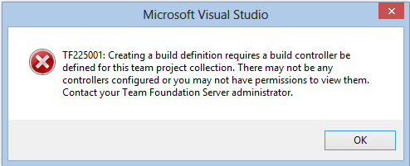
Automated Builds
Demo – define a new build
Need a build machine defined for the Project Collection

Slide 28
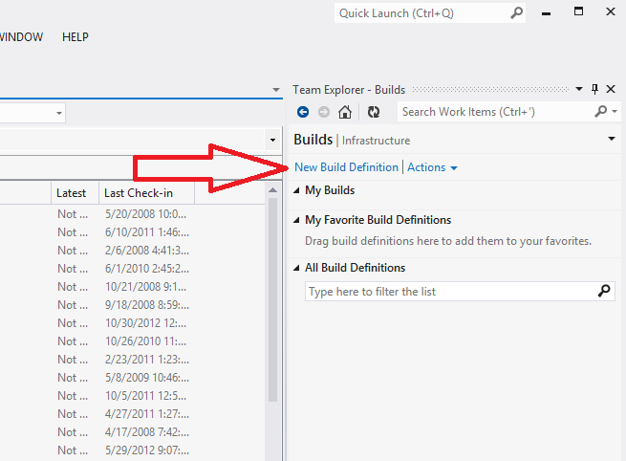
Automated Builds

Slide 29
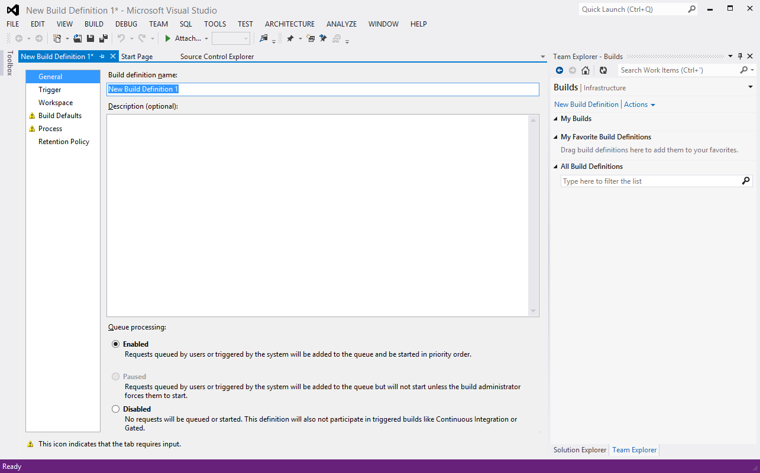
Automated Builds

Slide 30
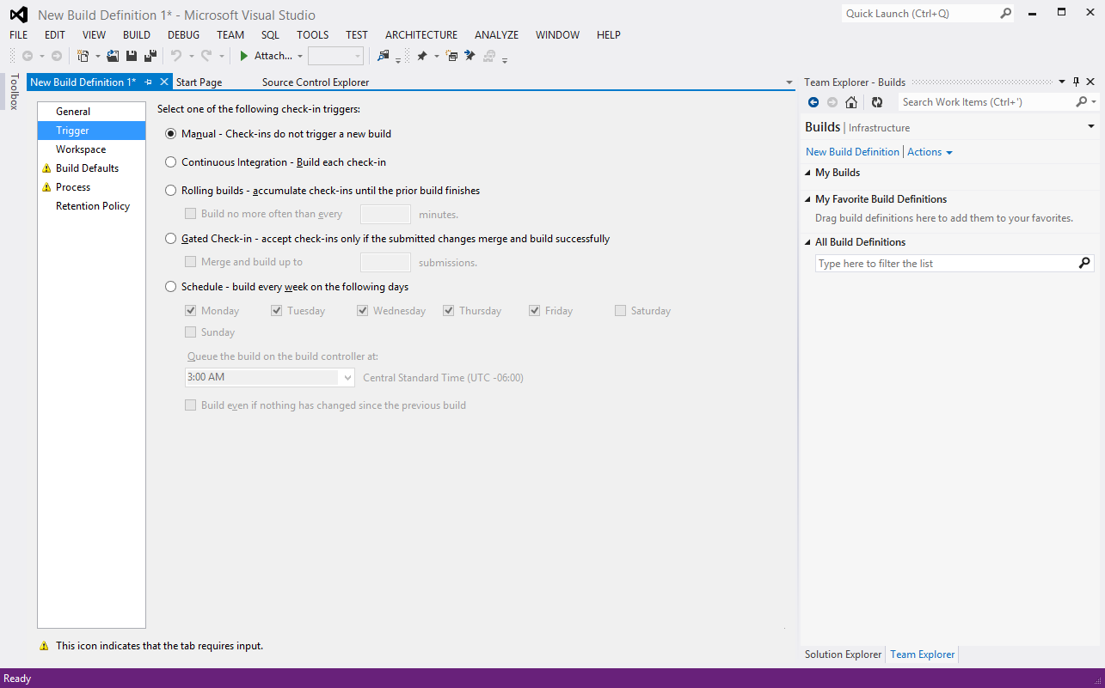
Automated Builds

Slide 31
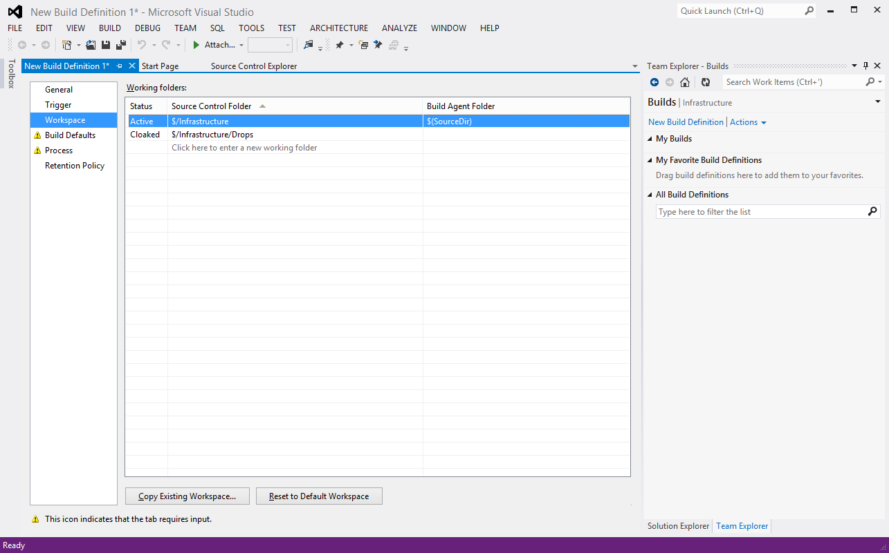
Automated Builds

Slide 32
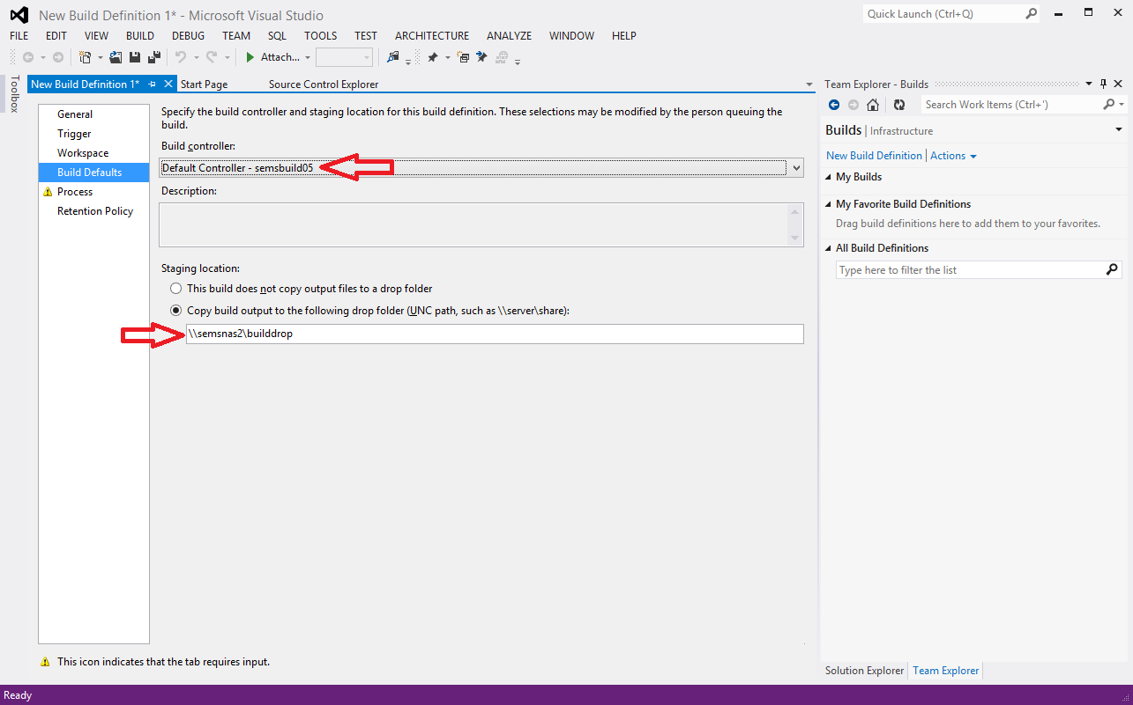
Automated Builds

Slide 33
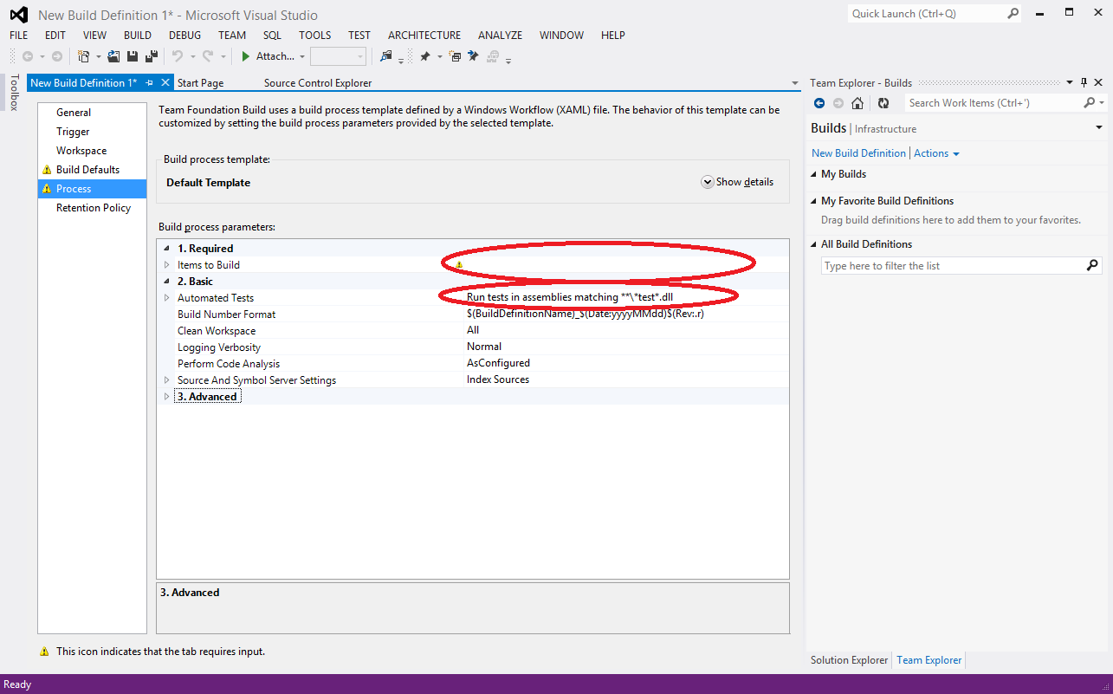
Automated Builds

Slide 34
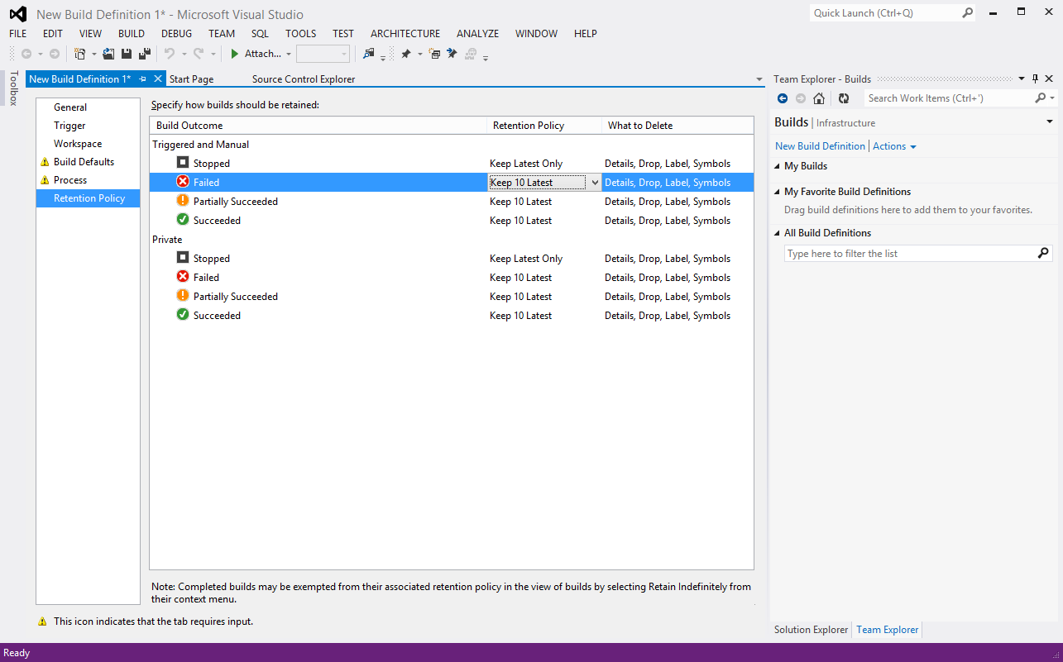
Automated Builds

Slide 35
Thank you!

Slide 36
Future Sessions
Session 2: Work Items, Project Management, and having TFS enforce our Process
Session 3: ???

Slide 37
Resources
SEMS Team Foundation Server: http://semstfs/
Team Foundation Server - Using Version Control: http://msdn.microsoft.com/en-us/library/ms181368(VS.100).aspx
Michael E. O’Brien meobrien@mmm.com (651) 733-4652

